Slide 1
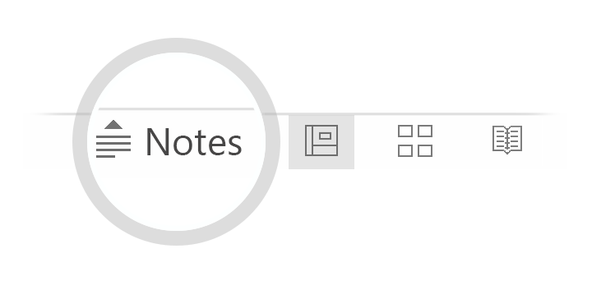
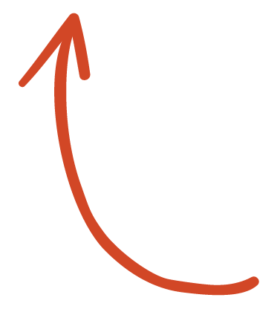
Analysis of Facebook News Articles by Category
Key facts about your topic
Criticism of Facebook has led to international media coverage and significant reporting of its legal troubles and the outsize influence it has on the lives and health of its users and employees, as well on its influence on the way media, specifically news, is reported and distributed. Notable issues include Internet privacy, such as use of a widespread "like" button on third-party websites tracking users, possible indefinite records of user information, automatic facial recognition software, and its role in the workplace, including employer-employee account disclosure.
See more: Open the Notes below for more information.
Notes:
QuickStarter has created an outline to help you get started on your presentation. Some slides include information here in the notes to provide additional topics for you to research.

Slide 2
Data Source
Buzzsumo website.
Most popular news articles on Facebook and other social media during the past 6 months.
Broken down into 10 categories
6 General categories - (Entertainment, Food, Health, Politics, Science, Sports)
4 Specific “Hot Button” categories during the first half of 2020. - (Covid, BLM, Trump, Biden)
10 .csv files were pulled form Buzzsumo searches that include the most popular 10,000 news articles for each topic over the past 6 months.

Slide 3
Facebook News Article analysis by Category for the first half of 2020.
LIKE, Share, Comments
Emotional Reaction
Clickbait Status

Slide 4
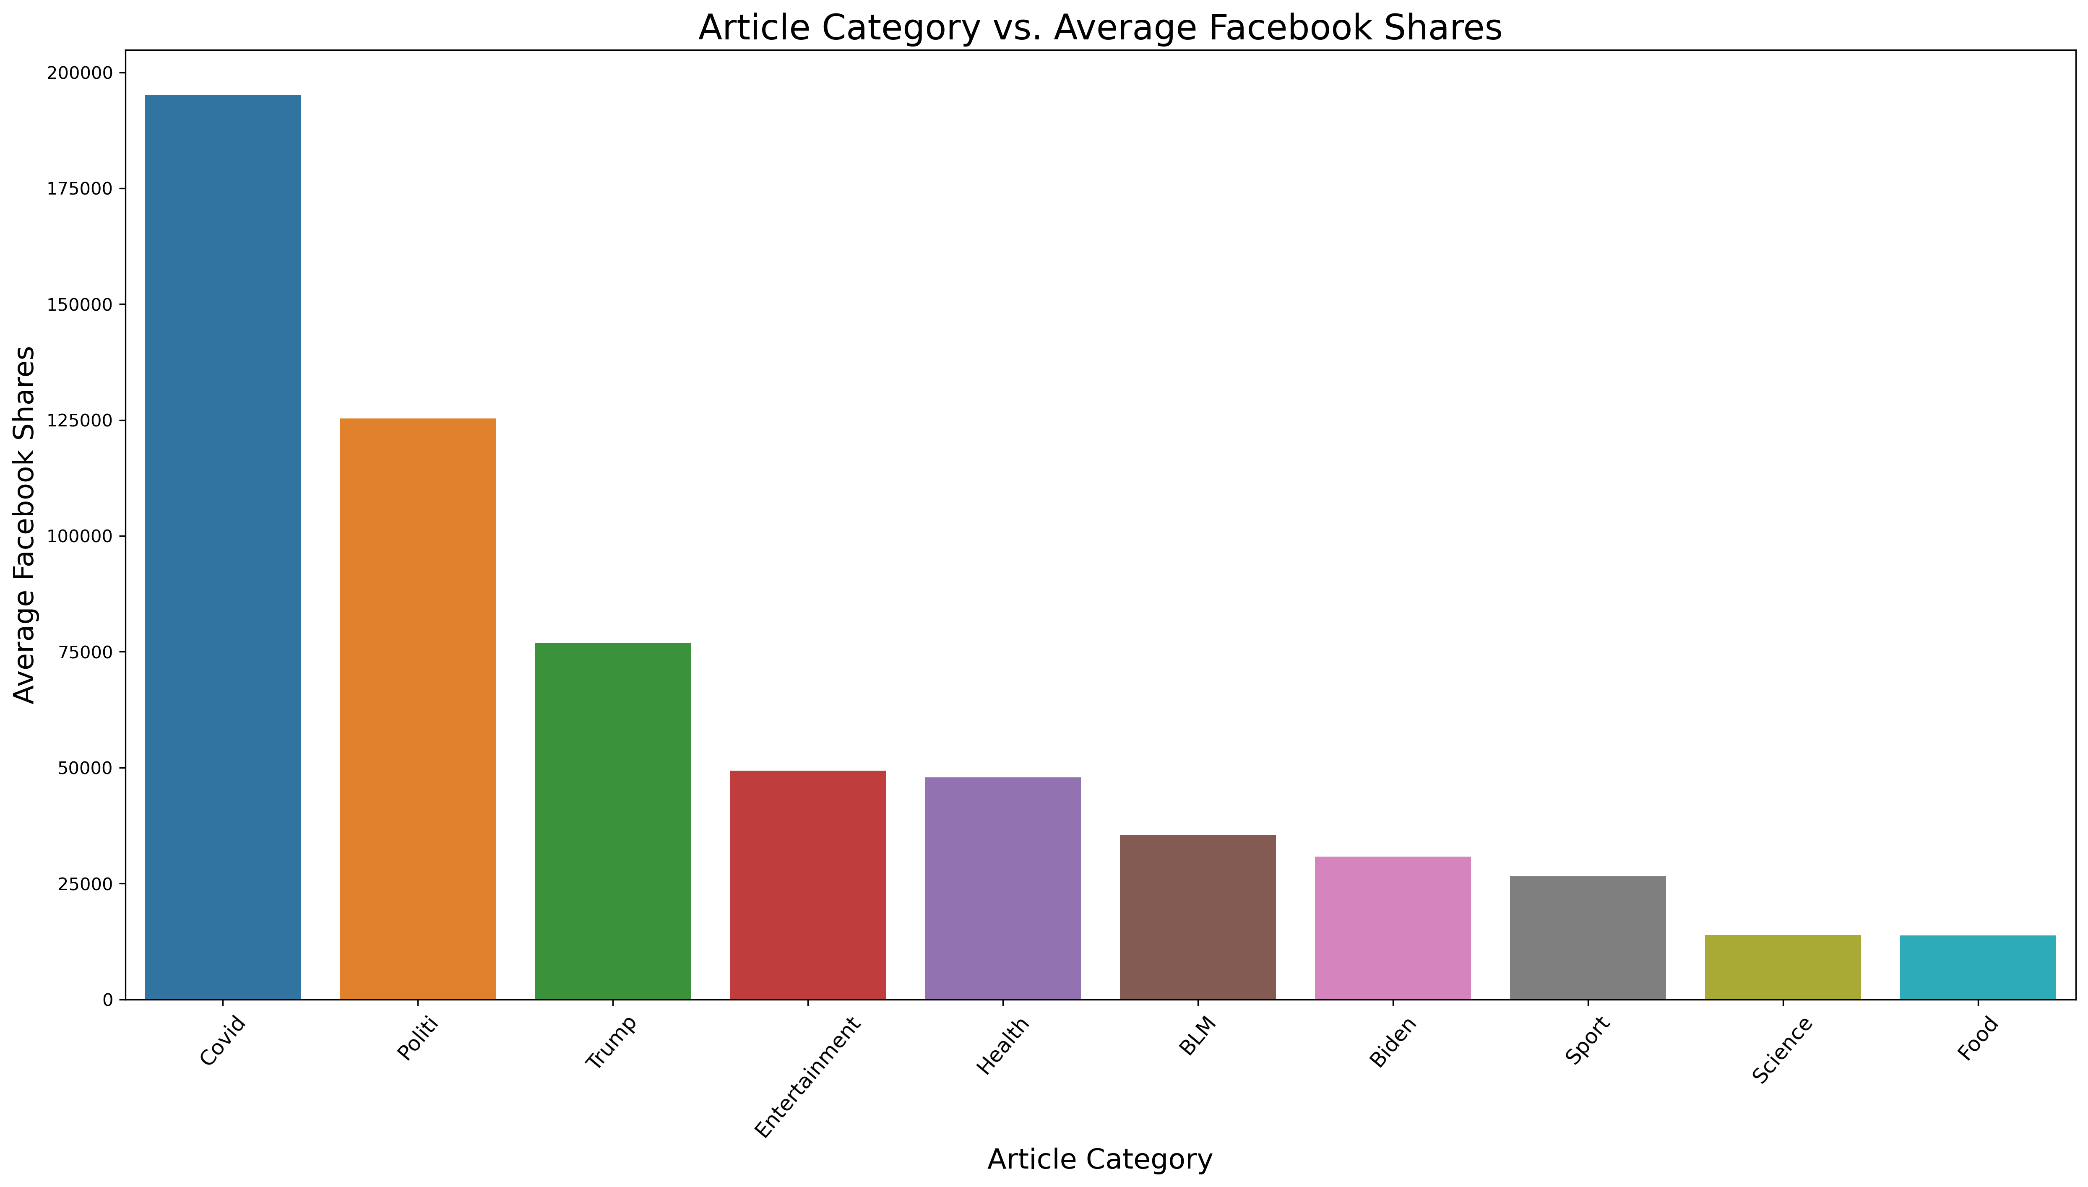
Overall Facebook Shares
Covid Articles Dominate the first half of 2020.
Trump has more than twice as many shares as Biden.
Entertainment is very popular.

Slide 5
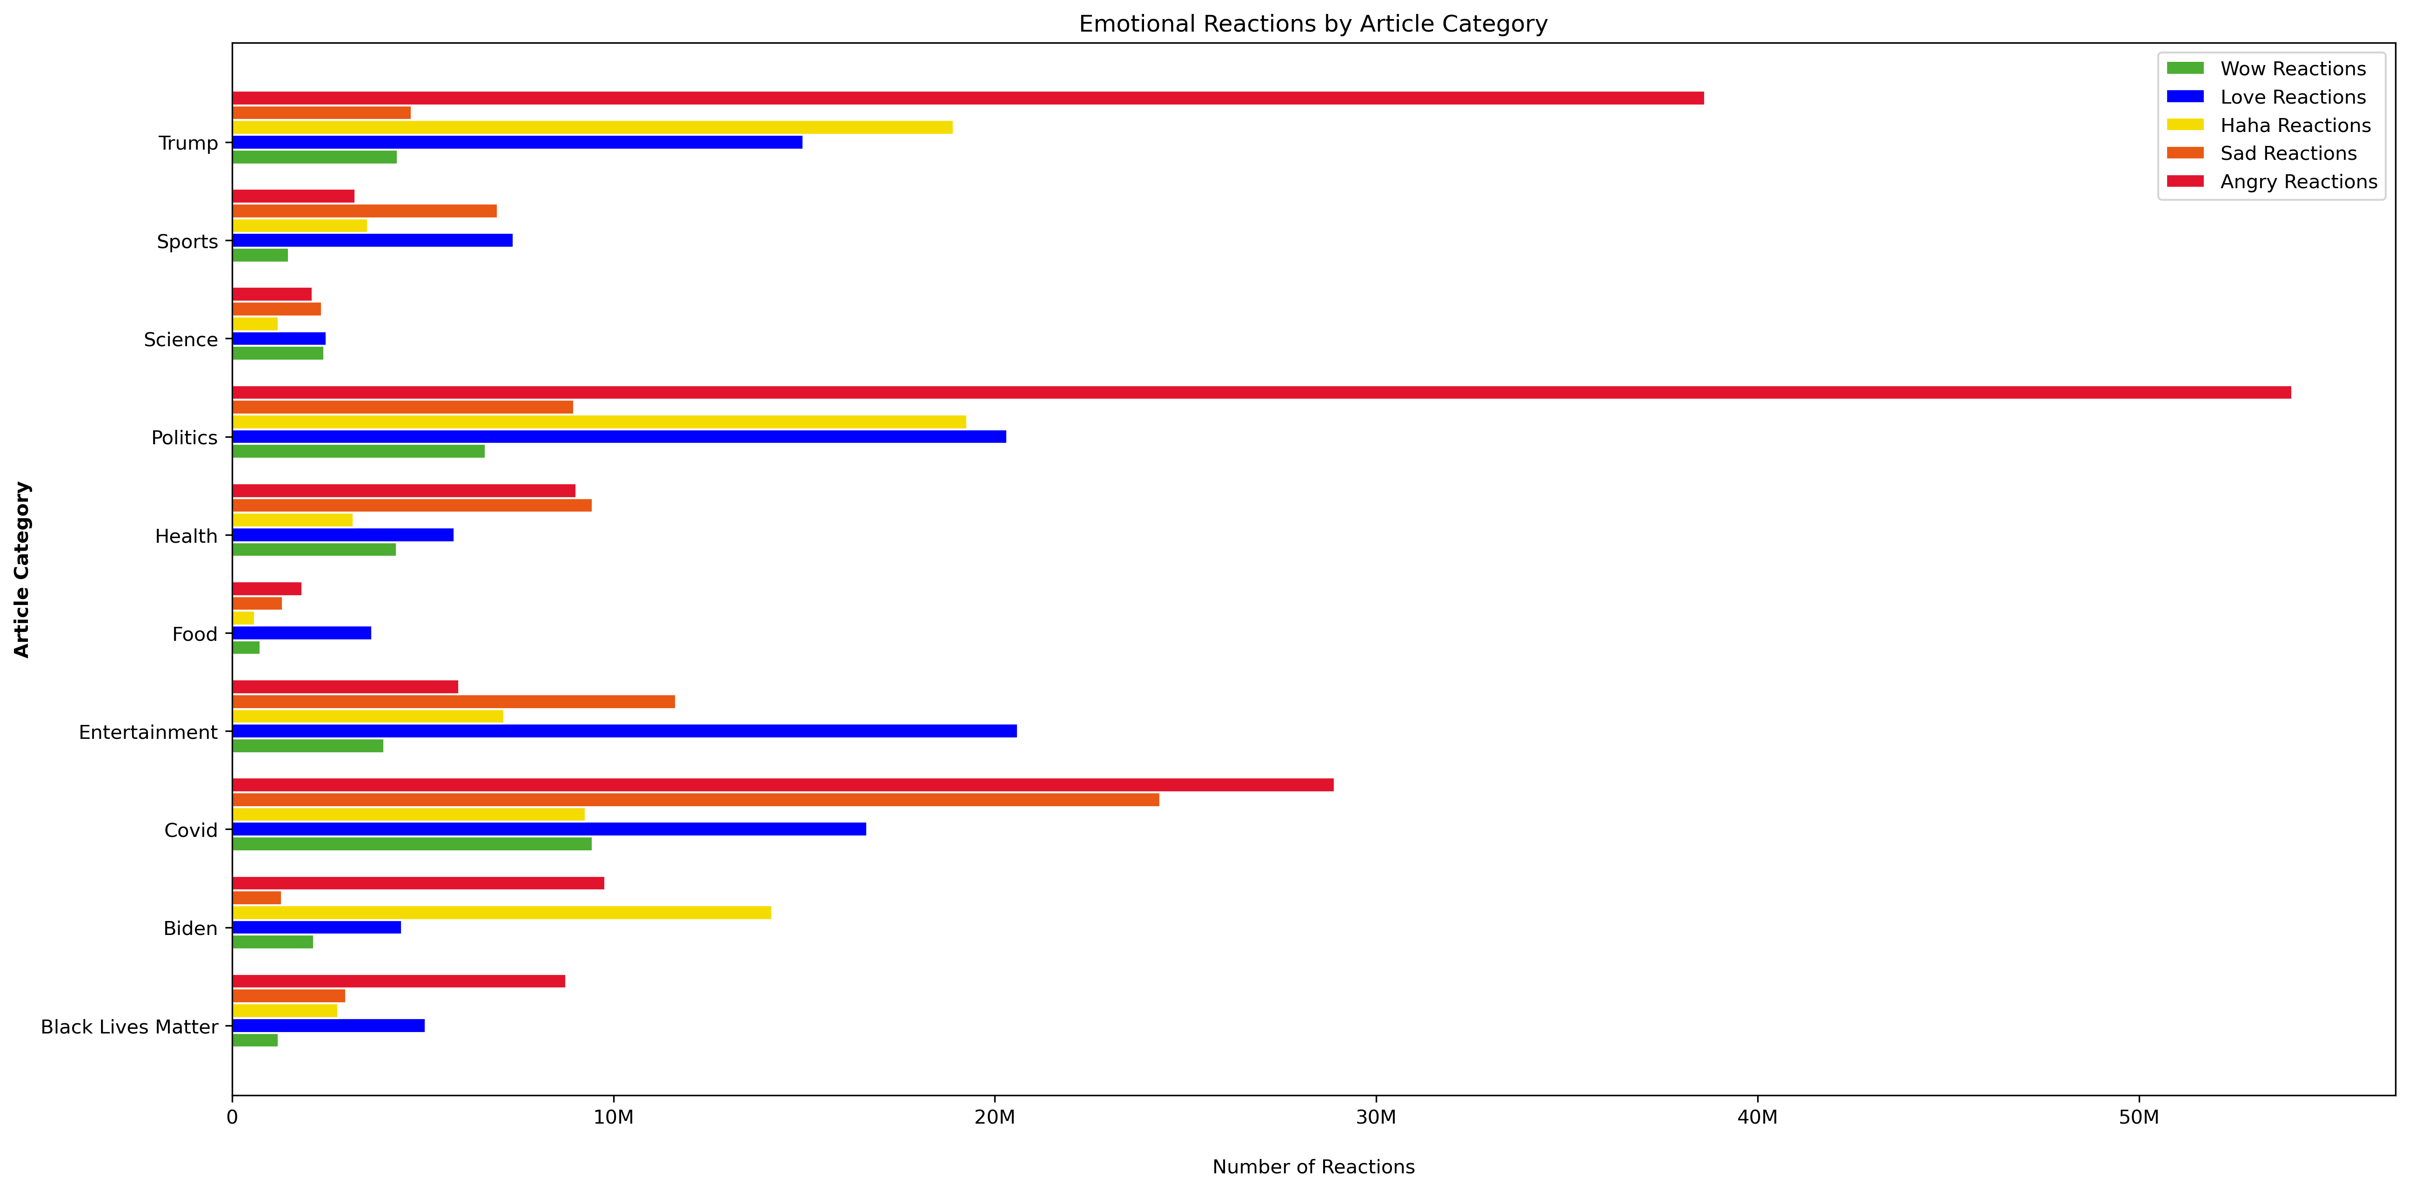

Slide 6
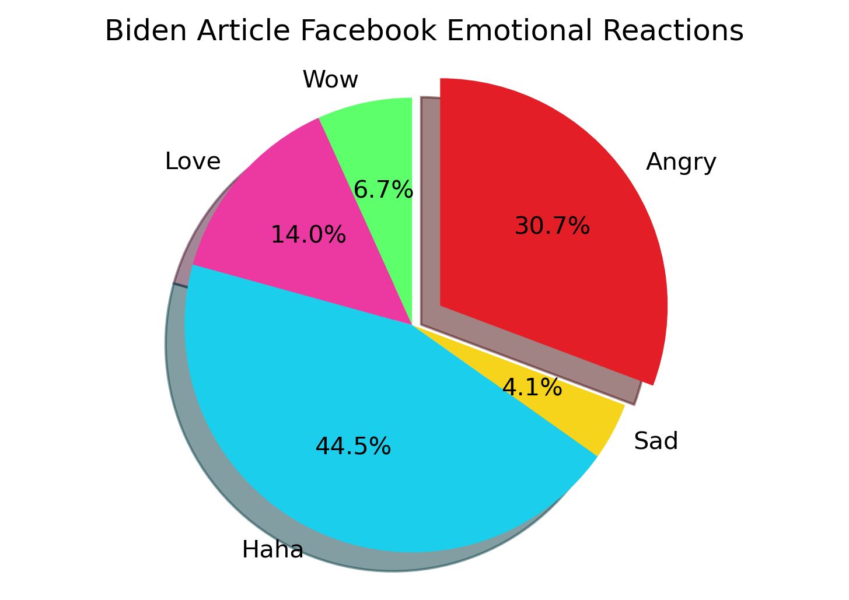
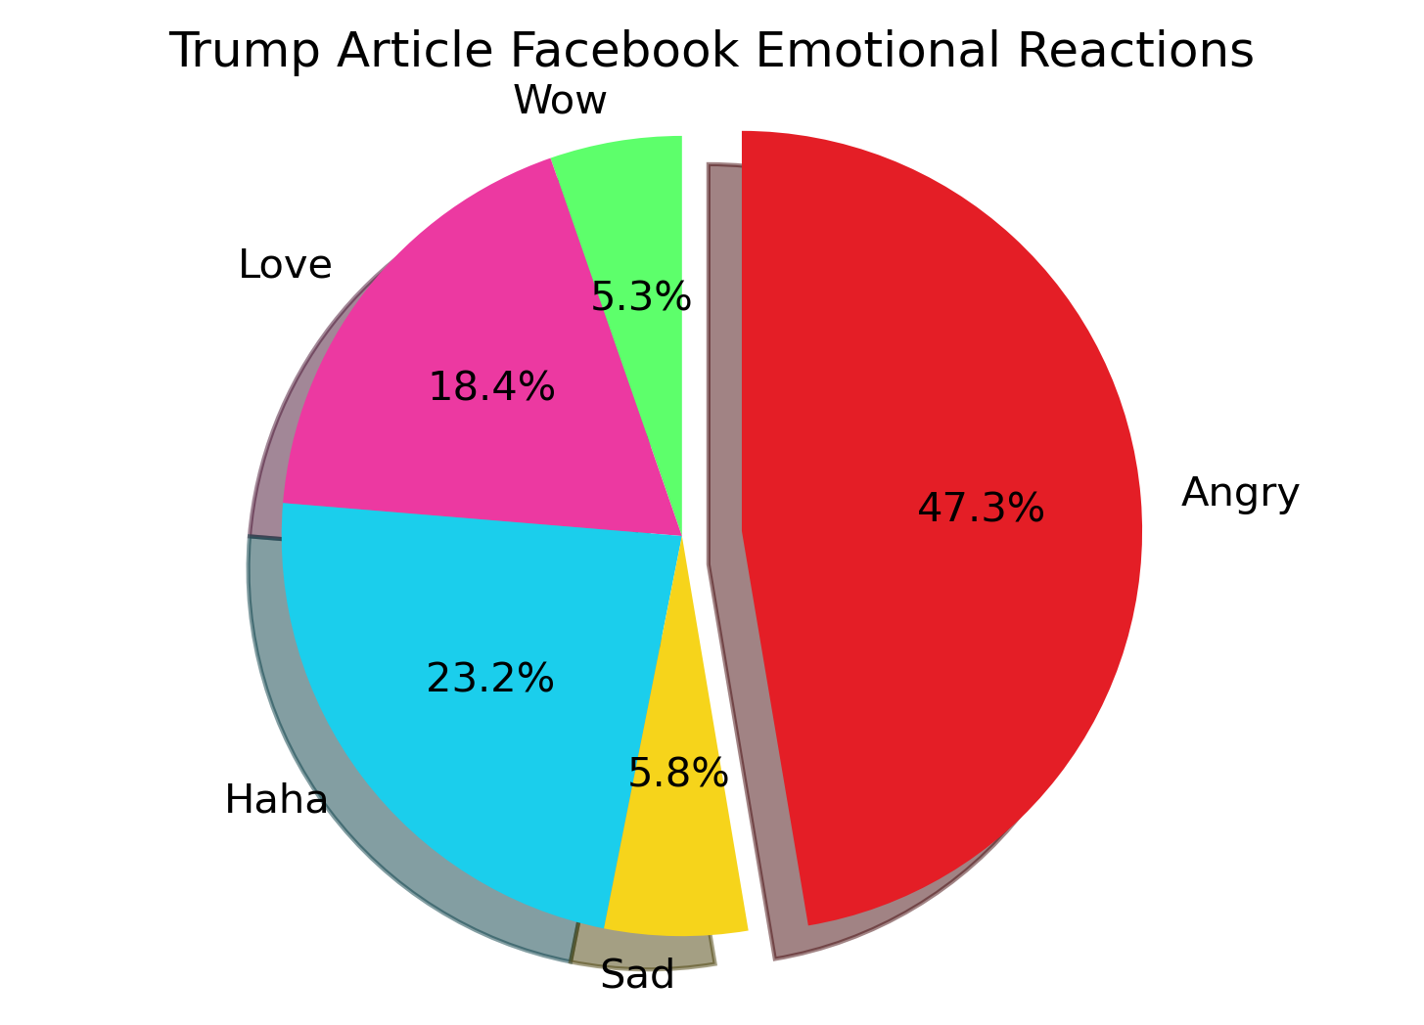
Trump vs. Biden emotional reactions

Slide 7
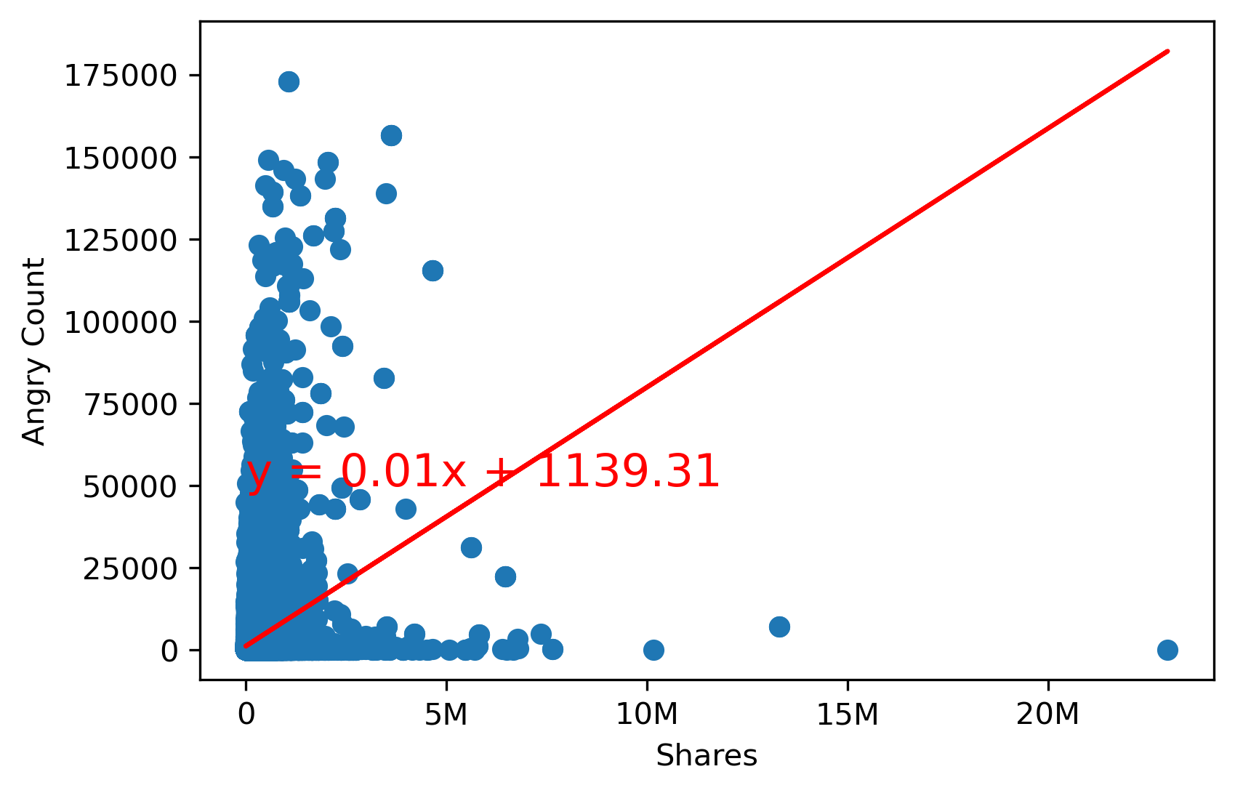
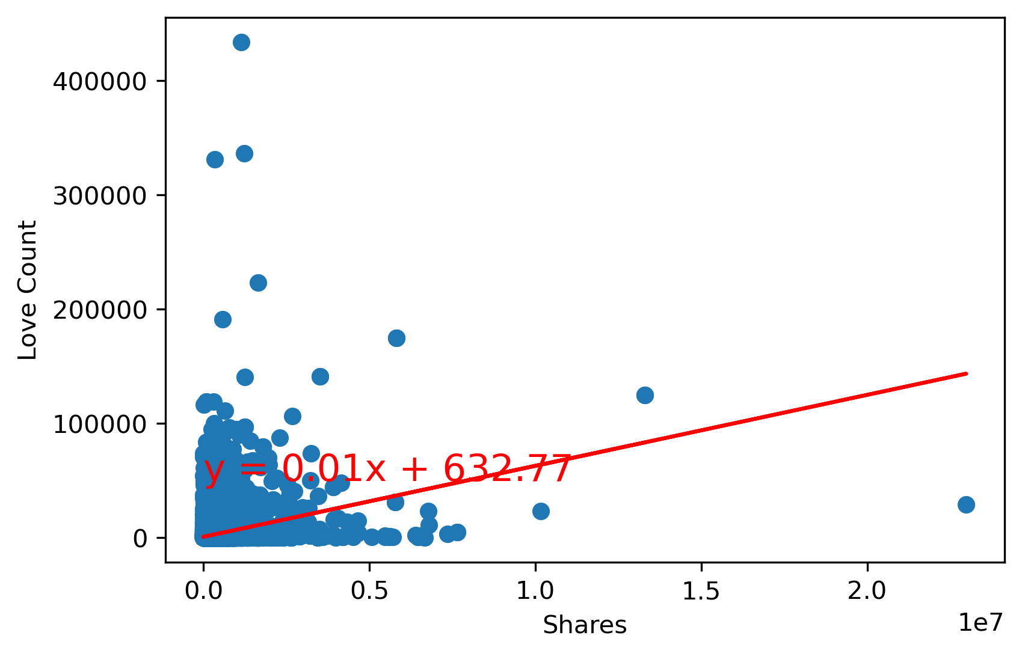
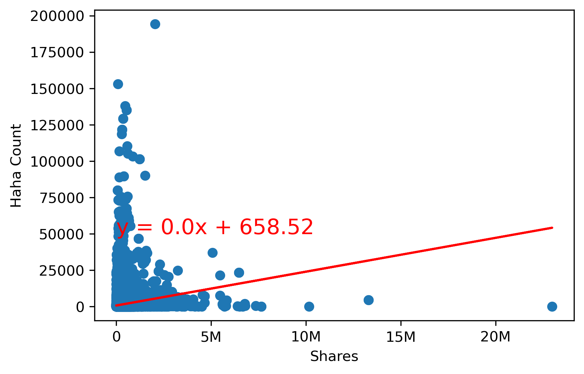
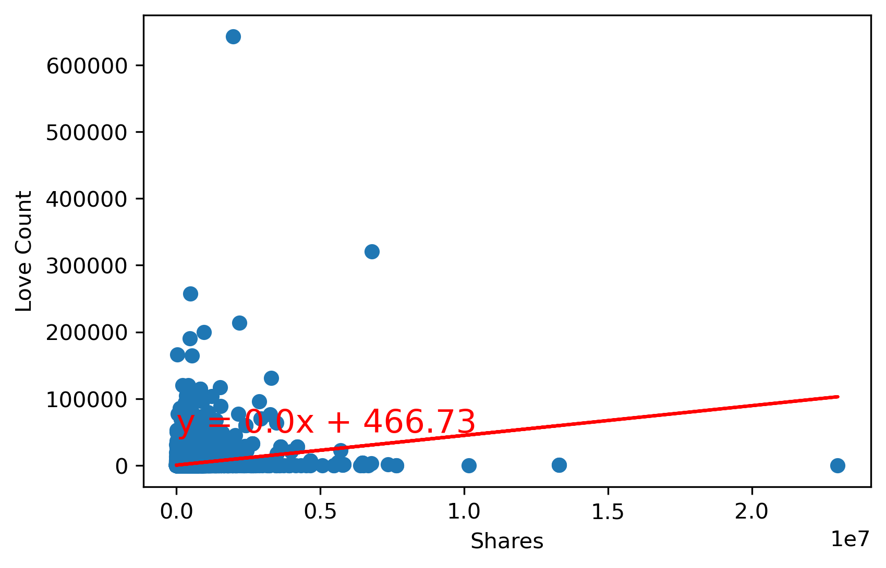
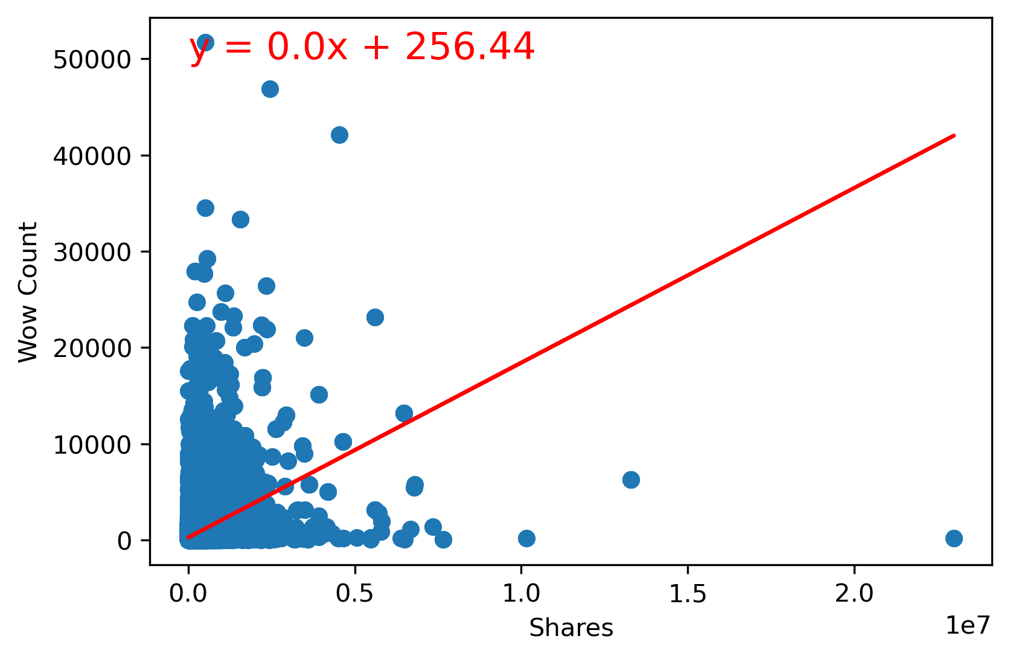
Facebook Article Shares Compared to Emotional Reactions.

